Slide 1
welcome

Slide 2
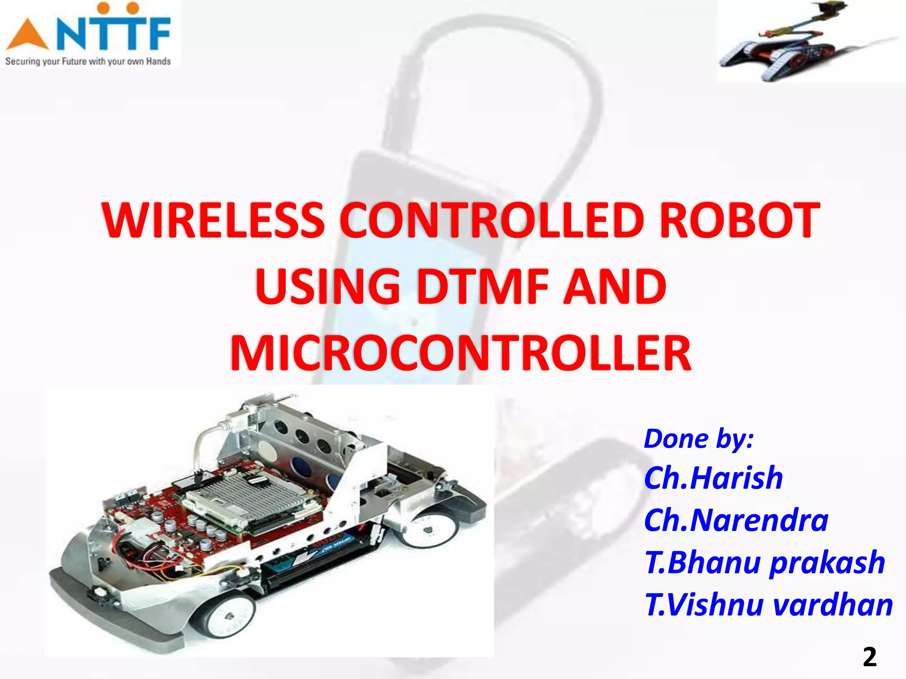
DONE BY :
SK . JOSHMEEN
K. DEEPTHI
P.SNEHA
S.BHARGAVI
D.VASHISTA

Slide 3
BILL OF MATERIALS
ARDUINO NANO
DTMF MODULE
L293D MOTOR DRIVE
BO GEAR MOTOR
BO WHEEL
CASTOR WHEEL
BREAD BOARD
JUMPERS
BATTERY

Slide 4
PROJECT OBJECTIVE
To overcome the problem of NLOS and range problems approach using mobile technology
Control the robot movement being anywhere in the world

Slide 5
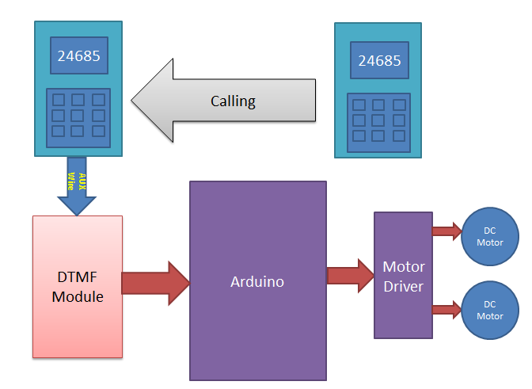
BLOCK DIAGRAM

Slide 6
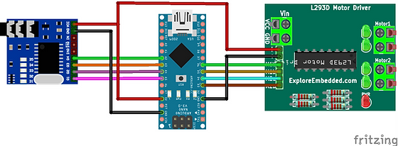
circuit diagram

Slide 7
DESCRIPTION OF THE BLOCK DIAGRAM
Cellphone controlled robots are used to operate the robot by using cellphone.
By connecting cellphone to the circuit the cellphone can control robot through the keypad of cellphone

Slide 8
cell phone
Cell phones are used to give the instructions to the robot by pressing the keypad of the cell phone .
The output of the cellphone controls the robot.
By generating dual tone ,the dual tone is given to the DTMF decoder .
Decoder decodes the frequency into digital data controls the robot .

Slide 9
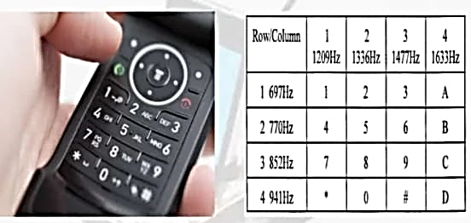

Slide 10
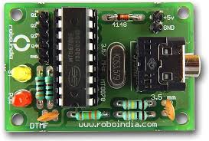
DTMF RECEIVER SECTION
DTMF receiver section is used to receive the dual tone coming from the cell phone.
It is received by the DTMF and decoded by the same DTMF to the micro controller .

Slide 11
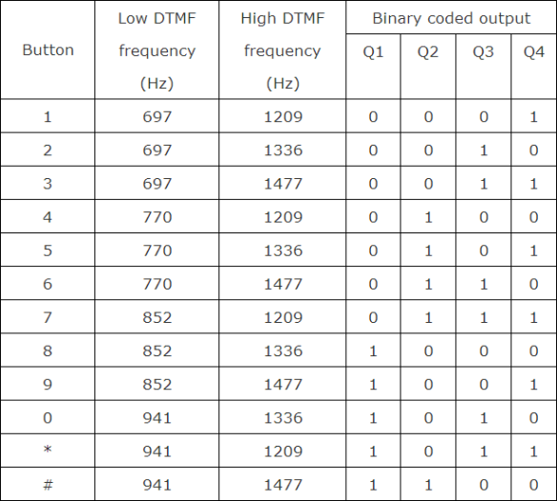
DTMF DECODER WORKING
This DTMF (Dual tone multi frequency) decoder circuit identifies the dial tone from the telephone line and decodes the key pressed on the remote telephone.
It employes electronics and computers to support switching operations .
DTMF is the ultimate technique used in any of the mobile telephone communication systems .

Slide 12
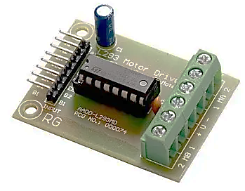
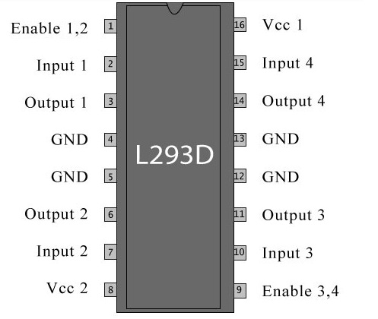
l293d motor drive
A motor driver is an integrated circuit chip which is usually used to control motors in autonomous robots. Motor driver act as an interface between Arduino and the motors . The most commonly used motor driver IC’s are from the L293 series such as L293D, L293NE, etc. These ICs are designed to control 2 DC motors simultaneously. L293D consist of two H-bridge. H-bridge is the simplest circuit for controlling a low current rated motor. We will be referring the motor driver IC as L293D only. L293D has 16 pins.

Slide 13
project working
In this

Slide 14
APPLICATIONS
Military and law enforcement
Search and rescue
Scientific
Home appliance control

Slide 15
future improvement and scope
IR sensors
Password protections
Alaram phone dialer
Adding a camera

Slide 16
Thank you

